Slide 1
Machine Learning
Lecture 19b: Unsupervised Clustering (II): K-means
Dr. Beilun Wang
Southeast University
School of Computer Science
and Engineering

Slide 2
Course Content Plan
Regression (supervised)
Classification (supervised)
Unsupervised models
Dimension Reduction (PCA)
Clustering (K-means, GMM/EM, Hierarchical )
Learning theory
Y is a continuous
Y is a discrete
NO Y
About f()
Graphical models
About interactions among X1,… Xp
Reinforcement Learning
Learn program to Interact with its environment

Slide 3



What is clustering?
Find groups (clusters) of data points such that data points in a group will be similar (or related) to one another and different from (or unrelated to) the data points in other groups
Inter-cluster
distances are maximized
Intra-cluster distances are minimized

Slide 4
Today
Definition of "groupness"
Definition of "similarity/distance"
Clustering Algorithms
Hierarchical algorithms
Partitional algorithms
Formal foundation and convergence
How many clusters?

Slide 5
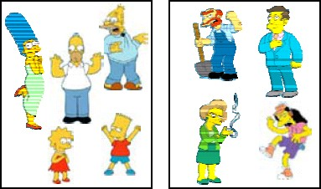
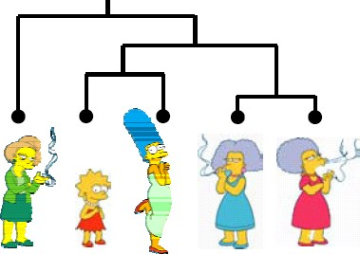
Clustering Algorithms
Partitional algorithms
Usually start with a random (partial) partitioning
Refine it iteratively
K means clustering
Mixture-Model based clustering
Hierarchical algorithms
Bottom-up, agglomerative
Top-down, divisive

Slide 6
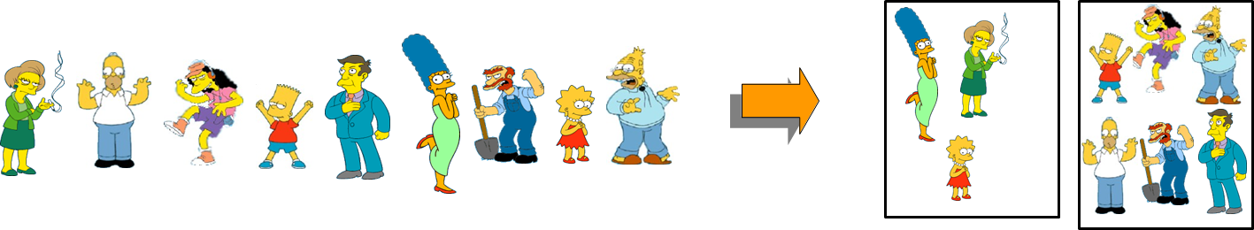
Partitional Clustering
Nonhierarchical
Construct a partition of n objects into a set of K clusters
User has to specify the desired number of clusters K.

Slide 7
Partitional Clustering (e.g. K=3)
Original points
Partitional clustering

Slide 8
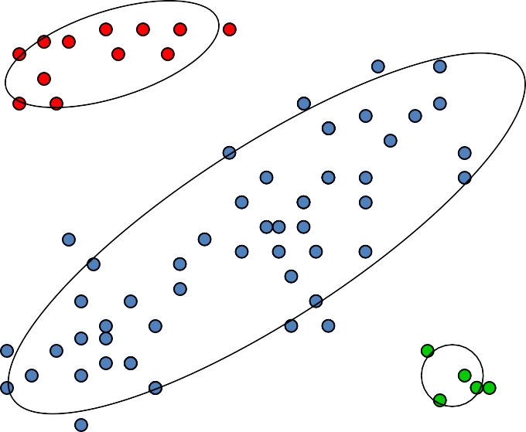
Partitional Clustering (e.g. K=3)
$$$
age

Slide 9
Clustering Algorithms
Partitional algorithms
Usually start with a random (partial) partitioning
Refine it iteratively
K means clustering
Mixture-Model based clustering

Slide 10
Partitioning Algorithms
Given: a set of objects and the number K
Find: a partition of K clusters that optimizes a chosen partitioning criterion
Globally optimal: exhaustively enumerate all partitions
Effective heuristic methods: K-means and K-medoids algorithms

Slide 11
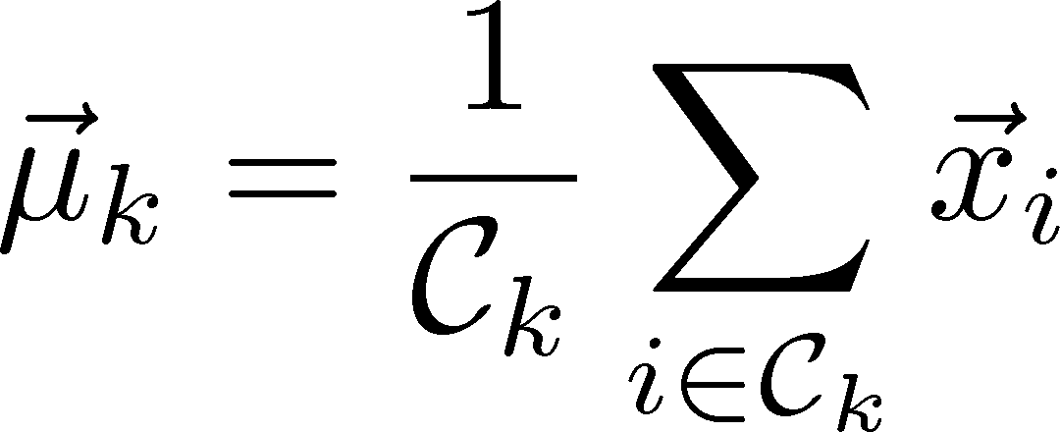
K-Means Algorithm
Decide on a value for k.
Initialize the k cluster centers randomly if necessary.
Decide the class memberships of the N objects by assigning them to the nearest cluster centroids (aka the center of gravity or mean)
Re-estimate the k cluster centers, by assuming the memberships found above are correct.
If none of the N objects changed membership in the last iteration, exit. Otherwise go to 3.

Slide 12
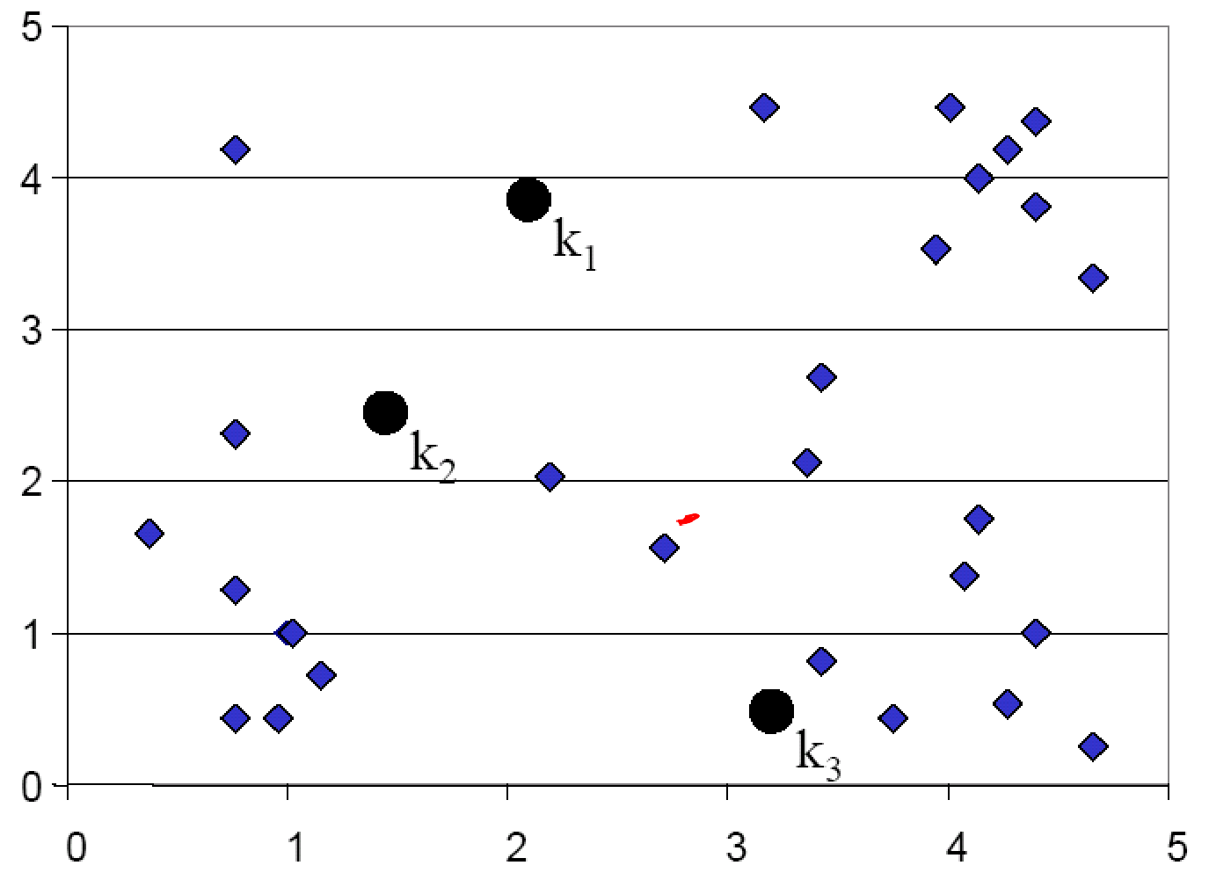
K-means Clustering: Step 1 Random guess of cluster centers

Slide 13
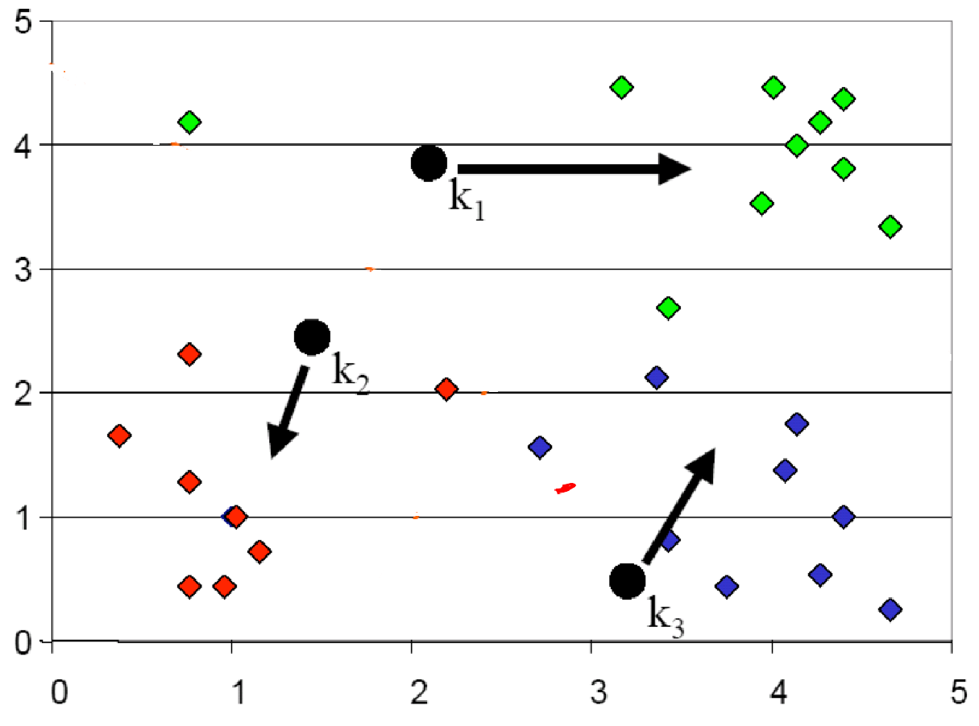
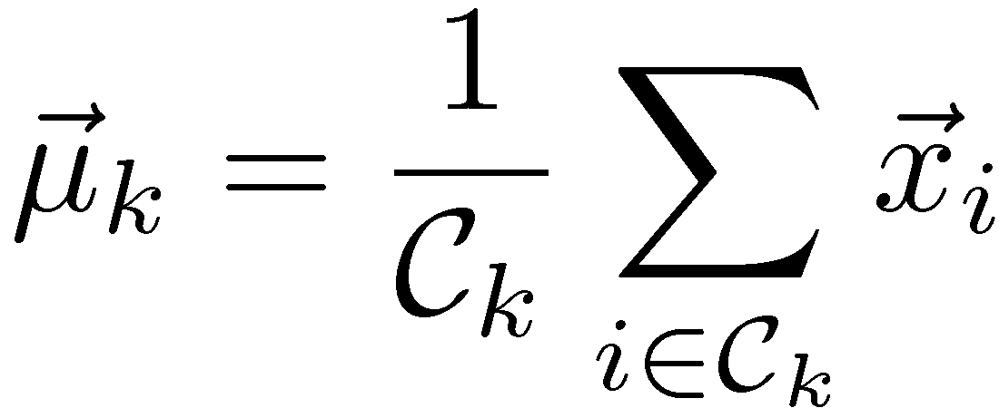
K-means Clustering: Step 2 Determine the membership of each data points

Slide 14
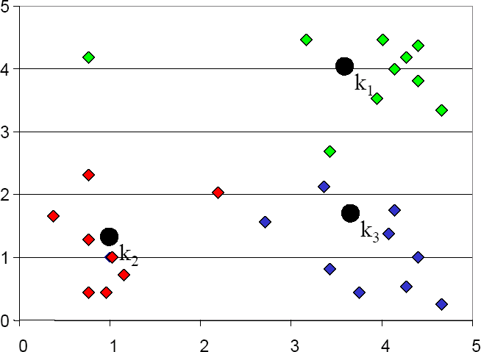
K-means Clustering: Step 3
Adjust the cluster centers

Slide 15
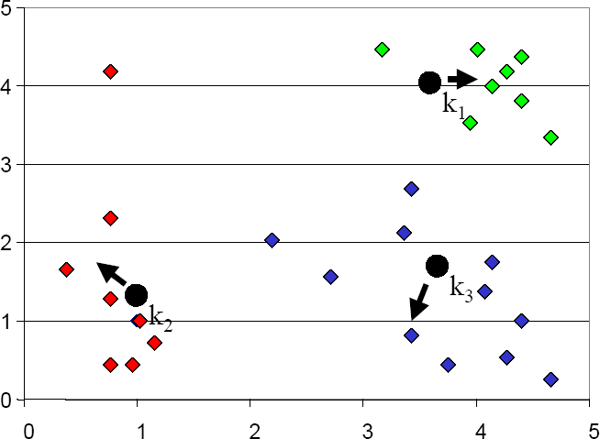


K-means Clustering: Step 4
Re-determine membership
Blue cluster gets more points

Slide 16
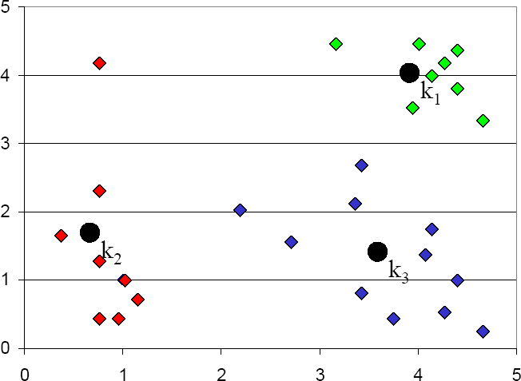
K-means Clustering: Step 5
Re-adjust cluster centers

Slide 17
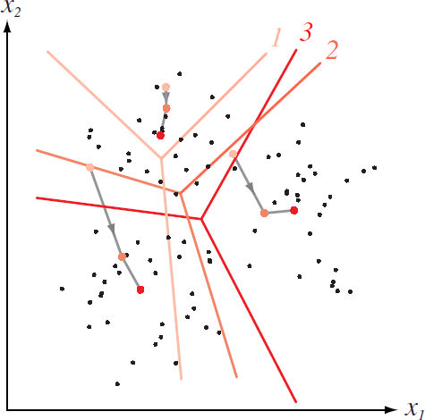
How K-means partitions?
For each set of K centroids (when fixed),
they partition the whole data space into K mutually exclusive subspaces to form a partition.
Changing positions of K centroids leads to a new partitioning.

Slide 18
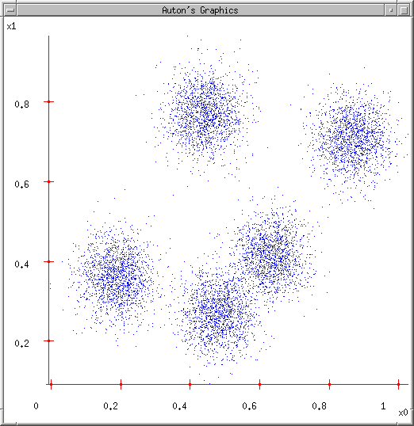
K-means: another Demo
K-means
Start with a random guess of cluster centers
Determine the membership of each data points
Adjust the cluster centers

Slide 19
K-means: another Demo
1. User set up the number of clusters they’d like. (e.g. k=5)

Slide 20
K-means: another Demo
User set up the number of clusters they’d like. (e.g. K=5)
Randomly guess K cluster Center locations

Slide 21
K-means: another Demo
User set up the number of clusters they’d like. (e.g. K=5)
Randomly guess K cluster Center locations
Each data point finds out which Center it’s closest to. (Thus each Center “owns” a set of data points)

Slide 22

K-means: another Demo
User set up the number of
clusters they’d like. (e.g. K=5)
Randomly guess K cluster centre locations
Each data point finds out which centre it’s closest to. (Thus each Center “owns” a set of data points)
Each centre finds the centroid of the points it owns

Slide 23

K-means: another Demo
User set up the number of clusters they’d like. (e.g. K=5)
Randomly guess K cluster centre locations
Each data point finds out which centre it’s closest to. (Thus each centre “owns” a set of data points)
Each centre finds the centroid of the points it owns
…and jumps there

Slide 24
K-means: another Demo
User set up the number of clusters they’d like. (e.g. K=5)
Randomly guess K cluster centre locations
Each data point finds out which centre it’s closest to. (Thus each centre “owns” a set of data points)
Each centre finds the centroid of the points it owns
…and jumps there
…Repeat until terminated!

Slide 25
K-means
Ask user how many clusters they’d like. (e.g. k=5)
Randomly guess k cluster Center locations
Each datapoint finds out which Center it’s closest to.
Each Center finds the centroid of the points it owns
Any Computational Problem?

Slide 26
K-means
Ask user how many clusters they’d like. (e.g. k=5)
Randomly guess k cluster Center locations
Each datapoint finds out which Center it’s closest to.
Each Center finds the centroid of the points it owns
Any Computational Problem?

Slide 27
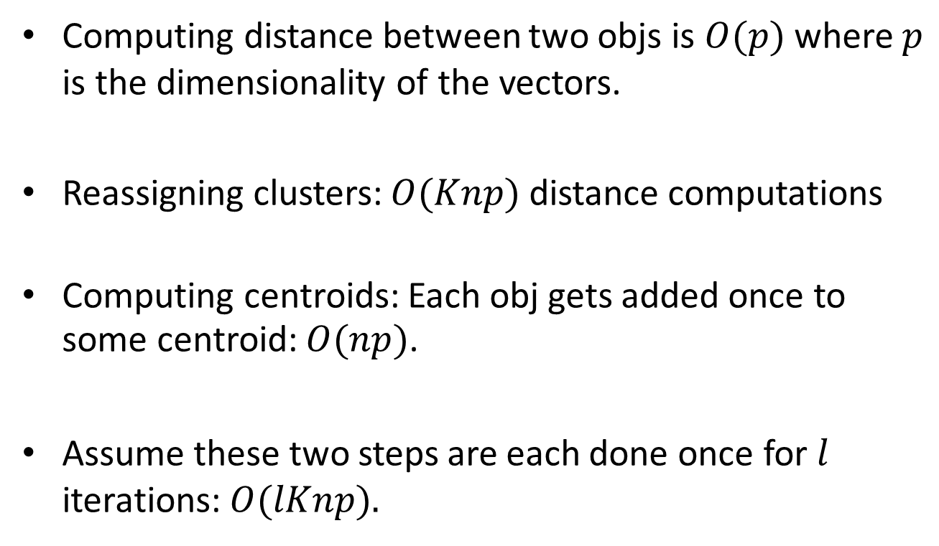
Time Complexity
Computing distance between two objs is $O(p)$ where $p$ is the dimensionality of the vectors.
Reassigning clusters: $O(Knp)$ distance computations
Computing centroids: Each obj gets added once to some centroid: $O(np)$.
Assume these two steps are each done once for $l$ iterations: $O(lKnp).$

Slide 28
Today
Definition of "groupness"
Definition of "similarity/distance"
Clustering Algorithms
Hierarchical algorithms
Partitional algorithms
Formal foundation and convergence
How many clusters?

Slide 29
How to Find good Clustering?
Find groups (clusters) of data points such that data points in a group will be similar (or related) to one another and different from (or unrelated to) the data points in other groups
Inter-cluster distances are maximized
Intra-cluster distances are minimized

Slide 30
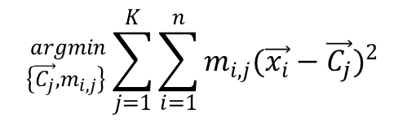


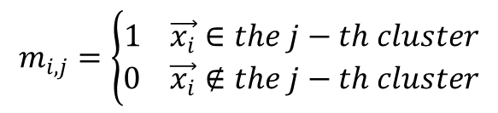
How to Find good Clustering? E.g.
Minimize the sum of
distance within clusters
$${}_{\left\{\vec{C_{j}},m_{i,j}\right\}}^{argmin}{ \sum_{j=1}^{K}{\sum_{i=1}^{n}{m_{i,j}(\vec{x_{i}}−\vec{C_{j}})^{2}}}}$$
C₁
C₂
$$m_{i,j}=\left\{\begin{aligned}1 \vec{x_{i}}∈the j−th cluster \\ 0 \vec{x_{i}}∉the j−th cluster\end{aligned}\right.$$
C₄
C
5
$$\sum_{j=1}^{K=5}{m_{i,j}=1}$$
C₃
$$→any \vec{x_{i}}∈a singer cluster$$
30

Slide 31
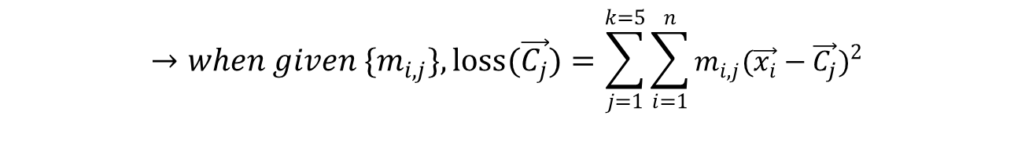
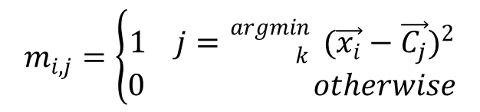
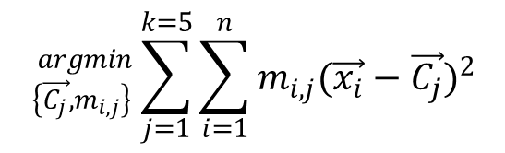
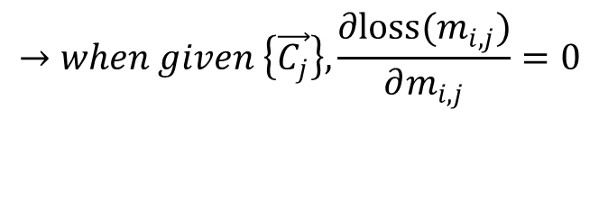
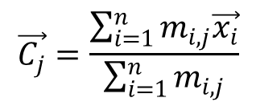
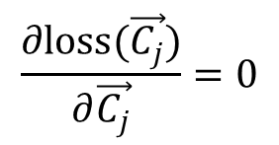
$${}_{\left\{\vec{C_{j}},m_{i,j}\right\}}^{argmin}{ \sum_{j=1}^{k=5}{\sum_{i=1}^{n}{m_{i,j}(\vec{x_{i}}−\vec{C_{j}})^{2}}}}$$
$$→when given{ \{m}_{i,j}\},loss(\vec{C_{j}})=\sum_{j=1}^{k=5}{\sum_{i=1}^{n}{m_{i,j}(\vec{x_{i}}−\vec{C_{j}})^{2}}}$$
$$\frac{∂loss(\vec{C_{j}})}{∂\vec{C_{j}}}=0$$
$$\vec{C_{j}}=\frac{\sum_{i=1}^{n}{m_{i,j}\vec{x_{i}}}}{\sum_{i=1}^{n}{m_{i,j}}}$$
$$→when given \left\{\vec{C_{j}}\right\}, \frac{∂loss{(m}_{i,j})}{∂m_{i,j}}=0$$
$$m_{i,j}=\left\{\begin{aligned}1 j={{}_{k}^{argmin} }_{ }(\vec{x_{i}}−\vec{C_{j}})^{2} \\ 0 otherwise\end{aligned}\right.$$

Slide 32
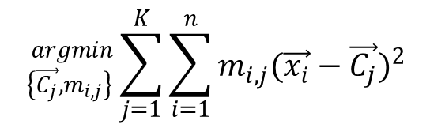
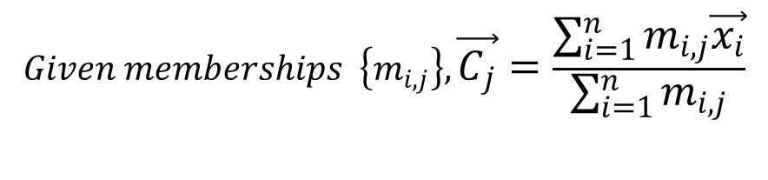
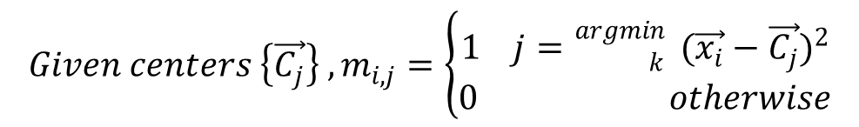
Iterative Optimization
$${}_{\left\{\vec{C_{j}},m_{i,j}\right\}}^{argmin}{ \sum_{j=1}^{K}{\sum_{i=1}^{n}{m_{i,j}(\vec{x_{i}}−\vec{C_{j}})^{2}}}}$$
$$Memberships { \{m}_{i,j}\} and centers \left\{\vec{C_{j}}\right\} are correlated.$$
$${Given centers \left\{\vec{C_{j}}\right\} ,m}_{i,j}=\left\{\begin{aligned}1 j={{}_{k}^{argmin} }_{ }(\vec{x_{i}}−\vec{C_{j}})^{2} \\ 0 otherwise\end{aligned}\right.$$
$$Given memberships \left\{m_{i,j}\right\},\vec{C_{j}}=\frac{\sum_{i=1}^{n}{m_{i,j}\vec{x_{i}}}}{\sum_{i=1}^{n}{m_{i,j}}}$$

Slide 33
Convergence
Why should the K-means algorithm ever reach a fixed point?
A state in which clusters don’t change.
K-means is a special case of a general procedure known as the Expectation Maximization (EM) algorithm.
EM is known to converge.
Number of iterations could be large.

Slide 34
Convergence
Optimize the goodness measure (i.e., minimize the Loss function)
sum of squared distances from cluster centroid.
Reassignment monotonically decreases the goodness measure since each vector is assigned to the closest centroid.

Slide 35
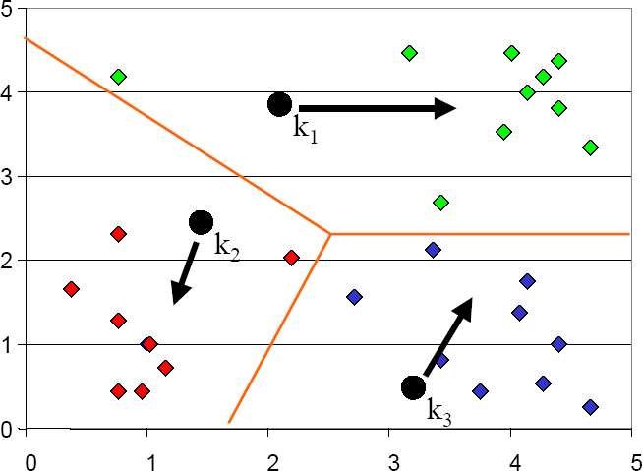
Seed Choice
Results can vary based on random seed selection.
Some seeds can result in poor convergence rate, or convergence to sub-optimal clustering.
Select good seeds using a heuristic (e.g., sample least similar to any existing mean)
Try out multiple starting points (very important!)
Initialize with the results of another method.

Slide 36
Today
Definition of "groupness"
Definition of "similarity/distance"
Clustering Algorithms
Hierarchical algorithms
Partitional algorithms
Formal foundation and convergence
How many clusters?

Slide 37
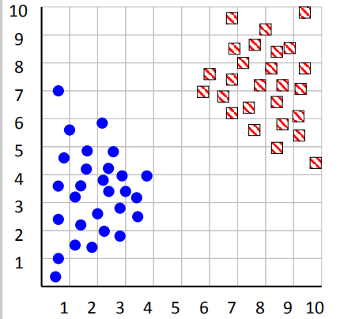
How can we tell the right number of clusters?
In general, this is a unsolved problem. However there exist many approximate methods.

Slide 38
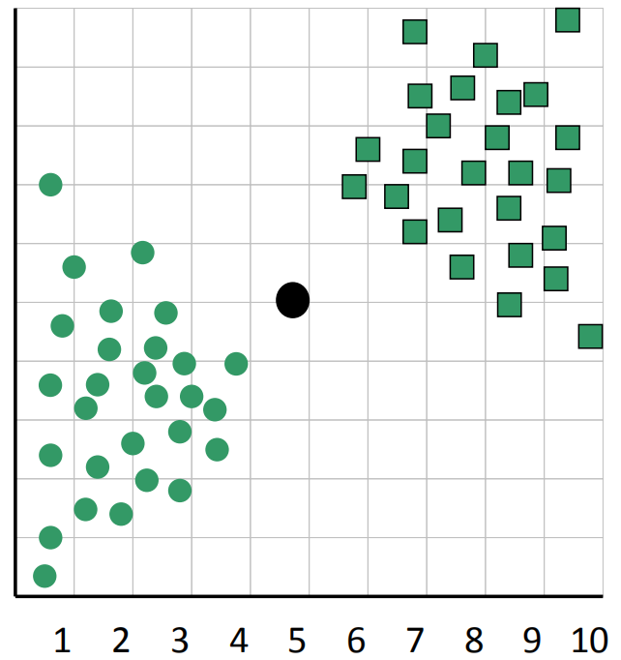
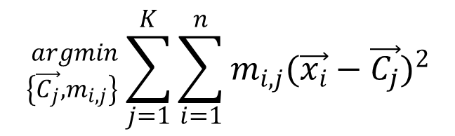
$${}_{\left\{\vec{C_{j}},m_{i,j}\right\}}^{argmin}{ \sum_{j=1}^{K}{\sum_{i=1}^{n}{m_{i,j}(\vec{x_{i}}−\vec{C_{j}})^{2}}}}$$
When k = 1, the objective function is 873.0

Slide 39
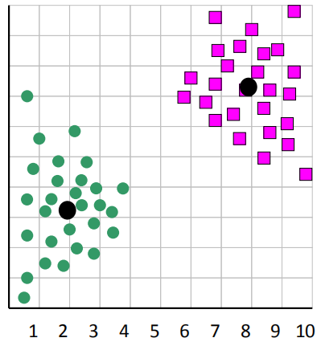
$${}_{\left\{\vec{C_{j}},m_{i,j}\right\}}^{argmin}{ \sum_{j=1}^{K}{\sum_{i=1}^{n}{m_{i,j}(\vec{x_{i}}−\vec{C_{j}})^{2}}}}$$
When k = 2, the objective function is 173.1

Slide 40
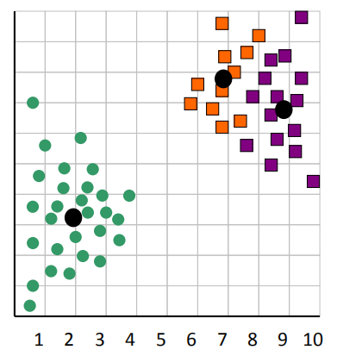
$${}_{\left\{\vec{C_{j}},m_{i,j}\right\}}^{argmin}{ \sum_{j=1}^{K}{\sum_{i=1}^{n}{m_{i,j}(\vec{x_{i}}−\vec{C_{j}})^{2}}}}$$
When k = 3, the objective function is 133.6

Slide 41
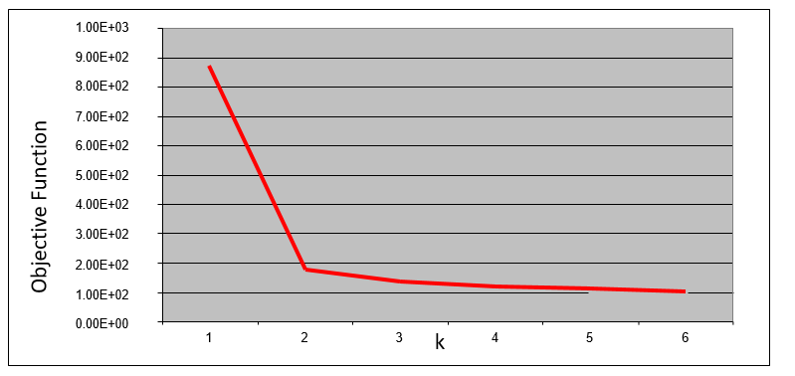
We can plot the objective function values for k equals 1 to 6…
The abrupt change at k = 2, is highly suggestive of two clusters in the data. This technique for determining the number of clusters is known as “knee finding” or “elbow finding”.
Note that the results are not always as clear cut as in this toy example.

Slide 42
What Is A Good Clustering?
Internal criterion: A good clustering will produce high quality clusters in which:
the intra-cluster similarity is high
the inter-cluster similarity is low
The measured quality of a clustering depends on both the data representation and the similarity measure used
External criteria for clustering quality
Quality measured by its ability to discover some or all of the hidden patterns or latent classes in gold standard data
Assesses a clustering with respect to ground truth
Example:
Purity
entropy of classes in clusters (or mutual information between classes and clusters)

Slide 43

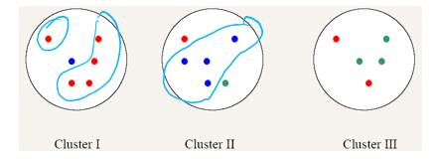
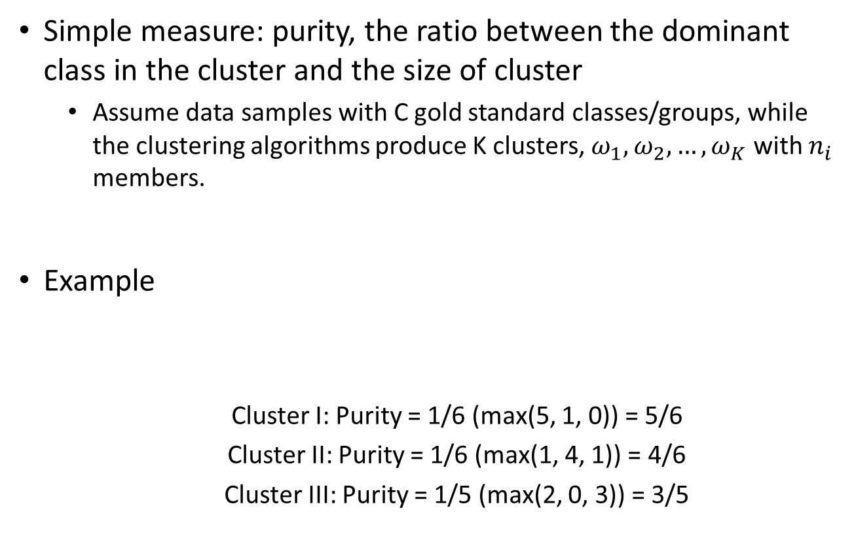
External Evaluation of Cluster Quality e.g. using purity
Simple measure: purity, the ratio between the dominant class in the cluster and the size of cluster
Assume data samples with C gold standard classes/groups, while the clustering algorithms produce K clusters, $ω_{1},ω_{2},…,ω_{K}$ with $n_{i}$ members.
Example
Cluster I: Purity = 1/6 (max(5, 1, 0)) = 5/6
Cluster II: Purity = 1/6 (max(1, 4, 1)) = 4/6
Cluster III: Purity = 1/5 (max(2, 0, 3)) = 3/5

Slide 44
References
https://qiyanjun.github.io/2019f-UVA-CS6316-MachineLearning/
Hastie, Trevor, et al. The elements of statistical learning. Vol. 2. No. 1. New York: Springer, 2009.
Big thanks to Prof. Eric Xing @ CMU for allowing me to reuse some of his slides
Big thanks to Prof. Ziv Bar-Joseph @ CMU for allowing me to reuse some of his slides
clustering slides from Prof. Rong Jin @ MSU

Slide 45
Thanks for listening

